Slide 1
Mixing rate as a measure of hemorrhagic vulnerability in intensive care unit (ICU) patients experiencing acute hypotensive episodes (AHE)
Brett Collar^{1,2}
Mohammad Adibuzzaman¹
Paul Griffin^{1,3}
¹Regenstrief Center for Healthcare Engineering, Purdue University, West Lafayette, USA
²School of Biomedical Engineering, Purdue University, West Lafayette, USA
³School of Industrial Engineering, Purdue University, West Lafayette, USA

Slide 2
Outline
Problem Description
Background
Mathematical Concepts
Shock Index (SI)
Animal Study (Previous Work)
Data
Algorithm
Results
Translational Study (Current Work)
Data
Approach
Results/Conclusion

Slide 3
Problem Description

Slide 4
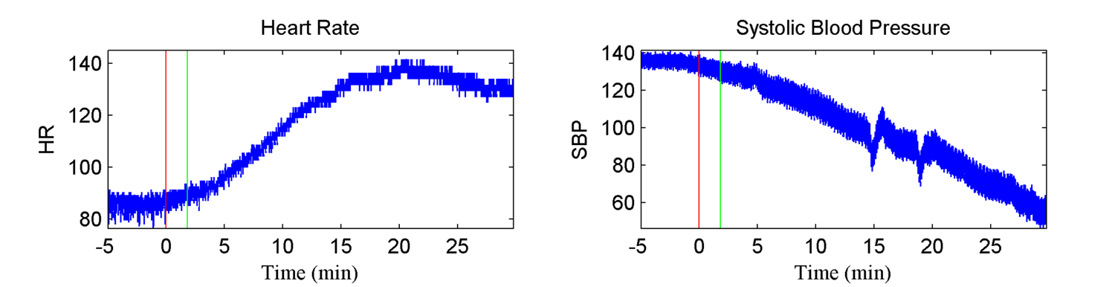
Hemorrhage, ahe and death
Hemorrhage leads to acute hypotensive episode (AHE) or shock, and shock leads to death.
Notes:
When regulatory mechanisms fail, shock happens:
Blood pressure remains unchanged for a long time
Heart rate increases (to compensate for low circulation and keep BP unchanged)
Eventually, blood pressure “craters”
However, many patients have reactions that do not follow this pattern, making shock diagnosis tricky

Slide 5
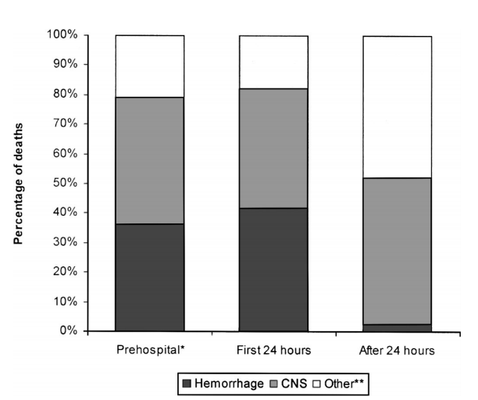
Problem Description
A METHOD IS NEEDED TO IDENTIFY PATIENTS THAT REQUIRE IMMEDIATE MEDICAL CARE
Hemorrhage results in over 80% of operating room deaths after major trauma [2]
Almost 50% of deaths in the first 24 hours of trauma care are due to hemorrhage [2]
Heart rate, mean arterial pressure, and shock index poorly predict the need for continued resuscitation and the effectiveness of treatment [1]
[2]
Notes:
Figure shows the causes of death at various phases of a patient’s stay in the hospital
- Prehospital ranges from before EMS arrive to before arriving at the hospital
- Other** deaths include combinations of hemorrhage/CNS injury
Problem Description
What is hemorrhage? Bleeding – blood escaping from the circulatory system
Causes: Different types of trauma (blunt, penetrating), medical procedures, coagulation disorders
Hemorrhage can lead to a host of complications, and eventually death
Why is it important to treat?
Hospital emergency departments
Triage situations
Battlefield treatment

Slide 6
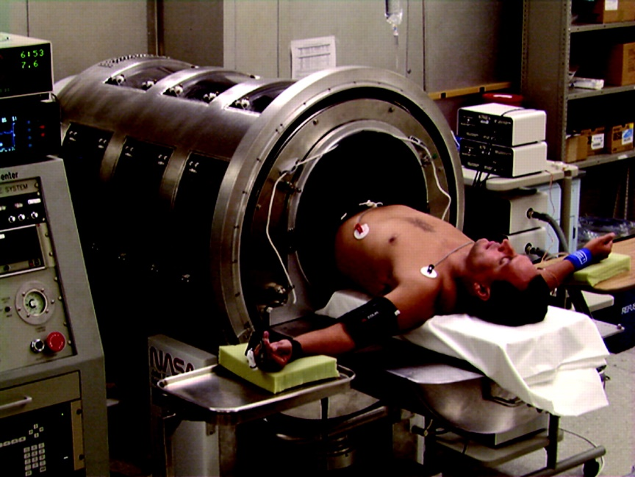
State of the art
Compensatory reserve index (cri)
Require ~30 heartbeats of baseline patient data
Estimates the remaining proportion of physiological reserve available to compensate for loss of blood volume [3]
Compares individual waveforms to a large library of reference waveforms (using lower body negative pressure (LBNP))
[3]
Notes:
Lower body negative pressure causes increased retention of blood in lower body, resulting in reduction of central blood volume
- Meant to imitate a hypotensive episode in the patient’s upper body
Goals:
Prospectively identify ongoing loss of blood volume [1]
Estimate the point at which individuals would experience hemodynamic decompensation well in advance compared to traditional vital signs

Slide 7
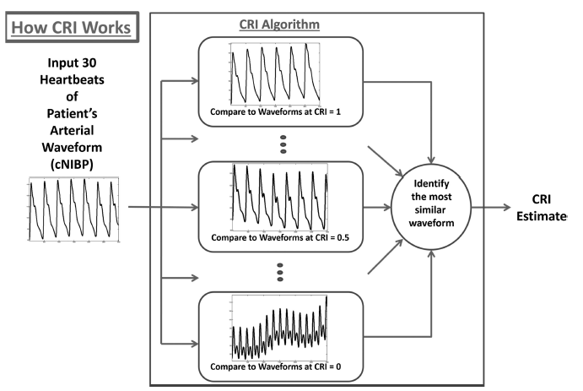
State of the art
CRI Algorithm
[3]
Notes:
1. ~30 heartbeats of baseline patient data
2. Compares individual waveforms to a large library of reference waveforms of different physiological reserves
3. Identify the most similar waveform
CRI normalized on a scale of 1 to 0
1 reflects maximum capacity of physiological mechanisms to compensate for reduced central blood volume
0 represents imminent cardiovascular instability and decompensation

Slide 8
Background

Slide 9
Markov Chain
Notes:
A process satisfies the Markov property predictions for the future of the process can be based solely on its present state, hence independently from history
Theory of a Markov chain is that the next value of a sequence depends solely on the current state
Future states can be predicted by creating a transition probability matrix

Slide 10
Eigenvalues
Notes:
Eigenvalues and left eigenvectors are determined from the transpose of the transition probability matrix [4]
The transition matrix P, if N x N, has N eigenvalues, all eigenvalues are on or inside the unit circle in the complex plane [5]
| A – λI | → Solving for eigenvalues
Eigenvalue == λ
Eigenvector == v

Slide 11
Mixing Rate
Notes:
SLEM = Second Largest Eigenvalue of the Markov Chain
The eigenvalue with the second largest magnitude is defined as the mixing rate
Represents the rate of convergence of the Markov chain to the uniform equilibrium distribution
Stationary distribution == limiting distribution
Stationary distribution → As the number of steps goes to infinity, the distribution over states converges to π (the eigenvector for which the eigenvalue is 1)

Slide 12
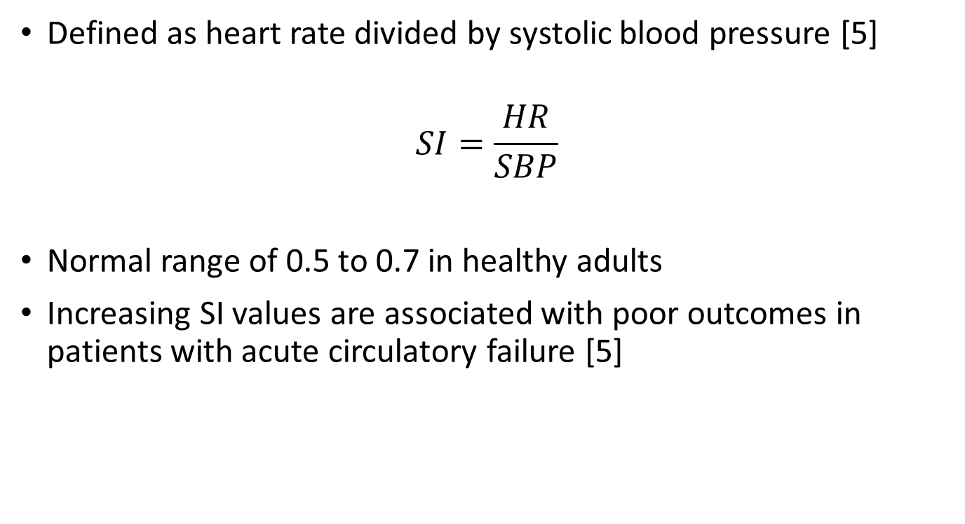
Shock Index (SI)
Defined as heart rate divided by systolic blood pressure [5]
$$SI=\frac{HR}{SBP}$$
Normal range of 0.5 to 0.7 in healthy adults
Increasing SI values are associated with poor outcomes in patients with acute circulatory failure [5]
Notes:
Used to identify high-risk septic patients
SI increases because heart rate increases to compensate, and BP eventually decreases

Slide 13
Animal Study (Previous Work)

Slide 14
Animal study: data
Immature swine (N=7)
Underwent continuous hemorrhage of 10 ml/kg over 30 minutes as SBP was recorded [4]
Eigenvalues were calculated for each window of 2000 samples (20 seconds)
Correlation coefficients determined between mixing rate and each vital sign (HR, SBP, PP, shock index)

Slide 15
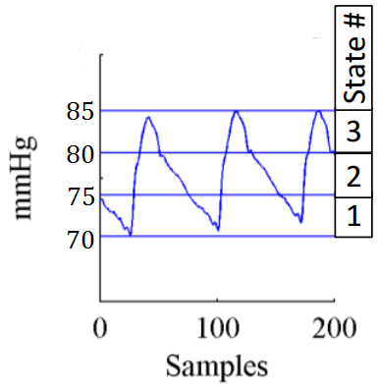
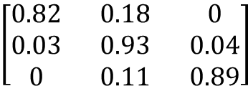
Algorithm
State 2 (75-80 mmHg)
$$\left[\begin{matrix}0.82 & 0.18 & 0 \\ 0.03 & 0.93 & 0.04 \\ 0 & 0.11 & 0.89\end{matrix}\right]$$
State 1 (70-75 mmHg)
State 3 (80-85 mmHg)
[4]
Arterial Blood Pressure
Markov Chain
Transition Probability Matrix
Notes:
From the waveform dataset, a Markov chain transition probability matrix is created
Create a matrix of m×m states, where the entry at the i^{th} row and j^{th} column represents the probability for which blood pressure changes from the i^{th} to the j^{th} state

Slide 16
Algorithm
Second largest eigenvalue, or the mixing rate of the transition probability matrix was computed
Notes:
Eigenvalues are calculated from the transpose of the transition probability matrix
Second largest eigenvalue is defined as the mixing rate

Slide 17
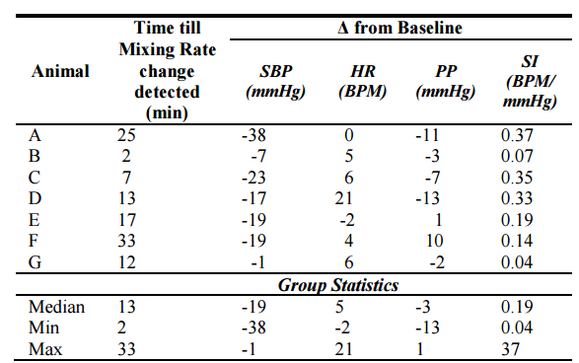
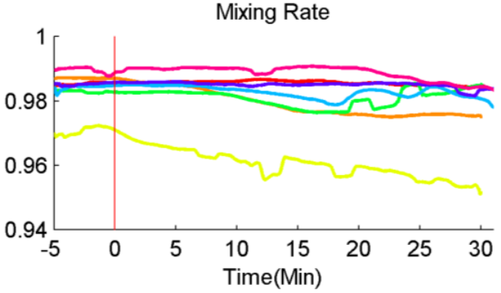
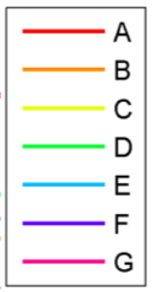
Animal study: Results
Mixing rates from each successive transition probability matrix are compiled into a single graph [4]
[4]
[4]
Notes:
SLEMs from successive windows (2000 samples) are plotted to make a single graph of mixing rate
Significant changes in mixing rate can be calculated from this graph
Table shows the median time that a significant change is detected using the mixing rate metric in swine compared to the change in shock index since baseline

Slide 18
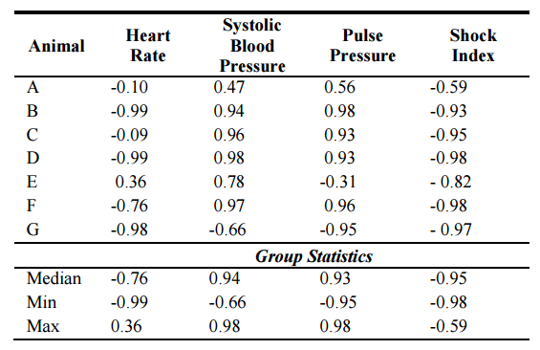
Animal study: Results
Correlation coefficients
[4]
Notes:
This table displays the correlation coefficients between mixing rate and HR, SBP, PP, and SI
- Shock index had an inverse correlation greater than 0.5 for all 7 swine samples

Slide 19
Translational Study (Current Work)
Does the algorithm work with Humans?

Slide 20
Translational study: Challenge Data
CINC Challenge Data 2009
Minute by minute data
Acute hypotensive episode (AHE) is defined a period of 30 minutes or more during which at least 90% of the mean arterial pressure (MAP) measurements were at or below 60 mmHg
Training data
Four groups, 15 records for each group
Group H1 (acute hypotensive episode in forecast window, treated with pressors)
Group H2 (AHE in forecast window, not treated with pressors)
Group C1 (records not containing acute hypotensive episodes)
Group C2 (AHE, but not in forecast window)
Notes:
In our research, we only considered patients in groups H1 and H2, as they were the only ones with identifiable hypotensive episodes

Slide 21
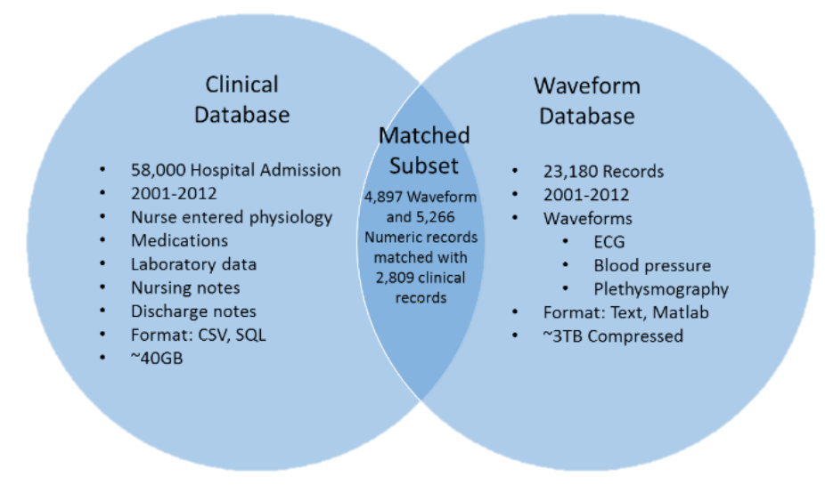
Translational study: mimic database
MIMIC Data
MIMIC II Waveform Database Matched Subset [6]
Challenge data in Matched Subset
Clinical records (SBP, DBP, MAP, HR) – 1 reading per minute [7]
Waveform records (ECGs, continuous blood pressure waveforms) – 125 samples per second [7]
[6]
Notes:
CINC Challenge Data came from the MIMIC II Waveform Database Matched Subset
Clinical records (1 per minute) → Used to calculate shock index
Waveform records (125 per second) → Used to calculate mixing rate
Use Matlab for waveform analysis

Slide 22
Translational study: Patient Data
MIMIC II Waveform database matched subset
Example Patient BP Waveform Data (125 Hz, ~72 hours total data, T₀ known):
T₀
(onset of forecast window)
Observation Window
(noncritical, 10 minutes)
AHE of Interest
(~30 minutes into Forecast Window)
Forecast Window
(60 minutes)
10 minutes prior to onset of forecast window to establish baseline
60 minutes of data in forecast window (AHE ~30 minutes into forecast window)
Notes:
What do we do with this database?
Find location of T₀ in dataset (given)
Collect 10 minutes of data prior to T₀ to establish baseline
Collect 60 minutes of data after T₀, find first instance of significant change to mixing rate
Approximately 30 minutes into forecast window

Slide 23
Translational Study: Results

Slide 24
Patient Waveforms
30 patient waveforms provided in the MIMIC III Database
23 patients had identifiable locations for T₀ in their waveform records
15 patients were visually identified to fit criteria of a decreased MR at AHE compared to baseline values
These 15 patients constitute the selected cohort
11 patients had AHEs with acceptable levels of noise/time since T₀
Mixing rate, shock index, heart rate, and systolic blood pressure waveforms were generated for all 15 patients in the selected cohort

Slide 25
Patient MR waveforms
Notes:
Background: 11 patient MR waveforms that fit criteria and do not contain excessive noise around AHE
Blue line: Average of all 11 patient waveforms

Slide 26
Patient SI Waveforms
Notes:
Shock index currently used to identify risk of patient outcomes

Slide 27
Patient HR Waveforms
Notes:
SI = HR / SBP

Slide 28
Patient SBP Waveforms
Notes:
SI = HR / SBP

Slide 29
Correlation coefficients
Correlation coefficients were calculated for all 23 patient waveforms
Calculations occurred from 10 minutes before T₀ to the acute hypotensive episode (AHE)
Correlation coefficients were obtained for SBP, SI, and HR
Patients organized in order of % change in MR (from baseline to AHE)
Notes:
AHEs were defined as the point from T0 to the end of the record that had the highest calculated shock index (SI = HR/SBP)
SBP, SI, and HR all obtained from numeric records on the MIMIC II Matched Database

Slide 30
Correlation coefficients with SBP, SI, and HR
Patient Number | SBP | Shock Index | Heart Rate | % Change MR (Baseline)
s19603 | 0.8193 | -0.8077 | -0.6748 | -0.2251%
s20658 | 0.5753 | -0.3518 | 0.2386 | -0.2023%
s22466 | -0.0078 | -0.0092 | 0.038 | -0.1358%
s23641 | 0.0158 | 0.0025 | 0.0239 | -0.0863%
s07125 | 0.5982 | -0.5942 | -0.7056 | -0.0735%
s20794 | 0.8584 | -0.8684 | Unavailable | -0.0726%
s12821 | 0.1294 | -0.2914 | -0.347 | -0.0573%
s02172 | 0.0876 | -0.1124 | -0.1619 | -0.0564%
s06349 | 0.7082 | -0.6724 | 0.5065 | -0.0386%
s21817 | 0.0058 | -0.0045 | -0.0248 | -0.0100%
s02395 | -0.4325 | 0.4357 | -0.0513 | 0.0129%
s23015 | -0.5404 | 0.4586 | -0.2274 | 0.0227%
s08718 | -0.6418 | 0.4193 | -0.5952 | 0.0257%
s25699 | -0.3199 | 0.332 | 0.172 | 0.0502%
s23594 | -0.1319 | 0.1455 | -0.0487 | 0.1011%
s15687 | -0.8177 | 0.6248 | -0.857 | 0.1149%
s05336 | -0.5601 | 0.3381 | -0.0564 | 0.1695%
s08779 | -0.5804 | 0.6766 | 0.0041 | 0.1790%
s24924 | -0.8445 | 0.815 | -0.5856 | 0.1888%
s19208 | -0.2093 | 0.3965 | 0.0088 | 0.2269%
s26105 | -0.9338 | 0.9018 | -0.8893 | 0.3470%
s23591 | -0.7713 | 0.7657 | -0.7379 | 0.3896%
s24799 | -0.6318 | 0.5606 | -0.6767 | 0.4338%
Notes:
Sorted according to % change in mixing rate
Bold rows signify the 15 patients that were visually identified as fitting the criteria for decreased MR
Red text signifies 4 patient samples that had too much noise to be considered useful
Animal model showed positive correlations to SBP, negative correlations to SI, and negative correlations to HR
4 Patients showed similarly high correlations in all three categories
Why do some patients follow the results of the swine study so closely, but not others?

Slide 31
Clinical hypotheses for change in mixing rate
Patient Number | Diagnosis | Age | Gender | Pressors?
s19603 | Acute Myocardial Infarction | 80 | F | No Pressors
s20658 | "Status Post" Abdominal Aortic Aneurysm (AAA) | 73 | F | Pressors
s22466 | Myocardial Infarction, Respiratory Distress | 78 | F | Pressors
s23641 | Acute Myocardial Infarction | 90 | M | No Pressors
s07125 | Gastroparesis\J-Tube Placement (Jejunostomy) | 51 | M | Pressors
s20794 | "Rule Out" Myocardial Infarction | 84 | M | Pressors
s12821 | Congestive Heart Failure, Pneumonia | 80 | F | Pressors
s02172 | Interstitial Pulmonary Fibrosis | 34 | M | No Pressors
s06349 | Congestive Heart Disease | 90 | F | Pressors
s21817 | Congestive Heart Failure | 71 | F | No Pressors
s02395 | Coronary Artery Disease | 79 | F | No Pressors
s23015 | Critical Aortic Stenosis, Transplant Evaluation | 67 | M | No Pressors
s08718 | Respiratory Failure | 84 | M | Pressors
s25699 | Cirrhosis | 39 | M | Pressors
s23594 | Pneumonia, Respiratory Failure | 73 | F | No Pressors
s15687 | Congestive Heart Failure\Cath/SDA | 88 | F | No Pressors
s05336 | Coronary Artery Disease | 45 | M | Pressors
s08779 | Coronary Artery Disease | 56 | M | No Pressors
s24924 | Coronary Artery Disease | 81 | F | No Pressors
s19208 | Congestive Heart Failure | 81 | F | Pressors
s26105 | CVA, Congestive Heart Failure, Pneumonia | 48 | M | No Pressors
s23591 | Shortness of Breath, "Rule Out" Myocardial Infarction, Telemetry | 86 | M | No Pressors
s24799 | Coronary Artery Disease | 66 | M | Pressors
Acute Myocardial Infarction
"Status Post" Abdominal Aortic Aneurysm (AAA)
Myocardial Infarction, Respiratory Distress
Acute Myocardial Infarction
Gastroparesis\J-Tube Placement (Jejunostomy)
"Rule Out" Myocardial Infarction
Congestive Heart Failure, Pneumonia
Interstitial Pulmonary Fibrosis
Congestive Heart Disease
Congestive Heart Failure
Coronary Artery Disease
No Pressors
Pressors
Pressors
No Pressors
Pressors
Pressors
Pressors
No Pressors
No Pressors
No Pressors
Pressors
Pressors
No Pressors
No Pressors
Pressors
No Pressors
No Pressors
Pressors
Notes:
Selected Cohort
CVA = Cerebrovascular Accident
Demographic Similarities:
8 of the top 11 “criteria-fitting” patients suffered from myocardial infarctions or heart disease
16 of all 23 patients suffered from MIs or heart disease
5 of the top 7 “criteria-fitting” patients received pressors
4 of the bottom 6 “criteria-fitting” patients did not receive pressors

Slide 32
Clinical hypotheses for change In mixing rate
Diagnosis:
Myocardial infarctions and heart disease account for 8 of the top 11 “criteria-fitting” patients
Age:
Average age of 12 subjects with biggest change: 73 years
Average age of 11 subjects with smallest change: 68 years
Not statistically significant (p = 0.47)
Drug Administration:
Patients administered pressors (vasoconstrictors) account for 5 of the top 7 selected cohort
Patients not administered pressors account for 4 of the bottom 6 selected cohort
Notes:
Possible explanation for the drug administration is that patients needing pressors were experiencing anesthesia-like effects (similar to swine from previous study, which were anesthetized) → Leading to largest changes in mixing rates

Slide 33
Comparing Vital Sign Changes
Group Statistics of all Patients
 | Time | ΔSBP | ΔSI | ΔHR
Median | 46 | -23.94 | 0.25 | -0.56
Min | 3 | -147.35 | 0.08 | -25.21
Max | 59 | 4.41 | 2.40 | 18.63
Group Statistics of “Selected Cohort” Patients
 | Time | ΔSBP | ΔSI | ΔHR
Median | 45 | -19.42 | 0.20 | 2.59
Min | 3 | -147.35 | 0.09 | -6.09
Max | 58 | 4.41 | 2.40 | 18.62
Group Statistics of Swine Study
 | Time | ΔSBP | ΔSI | ΔHR
Median | 13 | -19 | 0.19 | 5
Min | 2 | -38 | 0.04 | -2
Max | 23 | -1 | 0.37 | 21
Notes:
ΔSBP == Change from baseline before T0
If -147.3455 mmHg outlier is removed, minimum SBP becomes -51.8 → Much closer to the -38 mmHg from the swine study

Slide 34
Conclusions
A subset of patients displayed correlation coefficients similar to swine study
No significant differences for age or gender
Administration of pressors could explain why some patients more closely resemble results from previous swine study
Notes:
4 patients out of 23 had high correlations in

Slide 35
Future Work

Slide 36
Future Work
Identify additional patients in the MIMIC II Database Matched Subset that have undergone AHE
Continue analyzing current dataset for patterns with patient characteristics
Explore additional factors that may have effects on the accuracy and efficacy of the model

Slide 37
Additional Patients suffering Hemorrhage in MIMIC ii Database
Patients were identified by the ICD9 diagnosis codes of hospital records
ICD9 Code 578.9 considered most relevant to hemorrhagic bleeding
ICD9 Code | Number of Patients Diagnosed | Number of Patients in Matched Subset
459.0 (Hemorrhage) | 156 | 19
431 (Brain (miliary) (nontraumatic)) | 729 | 79
429.89 (Cardiovascular) | 39 | 4
998.11 (Surgical procedure complications) | 1008 | 143
432.9 (Cranial) | 39 | 6
430 (Membrane (brain)) | 352 | 36
423.0 (Pericardium, Pericarditis) | 66 | 18
578.9 (GI Bleed) | 938 | 162
Total | 3327 | 472
ICD9 Code | Number of Patients Diagnosed | Number of Patients in Matched Subset
459.0 (Hemorrhage) | 156 | 19
431 (Brain (miliary) (nontraumatic)) | 729 | 79
429.89 (Cardiovascular) | 39 | 4
998.11 (Surgical procedure complications) | 1008 | 143
432.9 (Cranial) | 39 | 6
430 (Membrane (brain)) | 352 | 36
423.0 (Pericardium, Pericarditis) | 66 | 18
578.9 (GI Bleed) | 938 | 162
Total | 3327 | 472
Notes:
ICD9 Code 578.9 considered most relevant to hemorrhagic bleeding

Slide 38
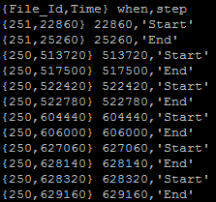
Additional patients suffering ahe from icd9 578.9
Utilized SciDB platform to process patient data
Applied algorithm to identify all AHE episodes within an individual subject’s hospital waveform
Example Output:
Time of Incidence (seconds)
File ID # of Waveform Record in Database
State of Incidence:
START – Onset of hypotensive episode
END – End of hypotensive episode
SINGLETON – Lone minute of AHE
Notes:
AHE episodes were identified according to minute-by-minute patient data of hospital records, then downloading high-frequency blood pressure waveforms for MR calculation

Slide 39
SCIDB R Program Data Analysis
Created R program to perform entire calculation process:
Identify patients with AHE and locate corresponding high-frequency file number
Download relevant high-frequency patient blood pressure data for identified window of AHE (including 60 minutes prior to onset of AHE)
Perform MR analysis on blood pressure data
Calculate correlation coefficients between MR and SBP, HR, and SI over entire sample

Slide 40
Patient AHE Data
162 ICD9 578.9 patients in matched subset, 47 analyzed:
8 patients found to suffer from AHE
Total of 81 hypotensive episodes identified within patient subset
Hypotensive episodes per patient ranged from 3 to 39

Slide 41
Correlation Coefficients of New Patient Data
Patient | Avg. Heart Rate Correlation | Avg. Systolic Blood Pressure Correlation | Avg. Shock Index Correlation
A | 0.07959601157 | 0.03768396642 | 0.0004311451379
B | -0.1198765981 | -0.08486558674 | -0.04757779805
C | -0.01502397621 | -0.04894702009 | -0.05558580767
D | -0.09486908437 | 0.01003627051 | 0.03668913713
E | -0.04365232787 | -0.390838561 | -0.3678173148
F | -0.02614974586 | -0.05002702797 | -0.04349202321
G | 0.04018569065 | -0.03655016186 | -0.03615903221
H | -0.00019358366 | 0.0232724723 | 0.0282115696

Slide 42
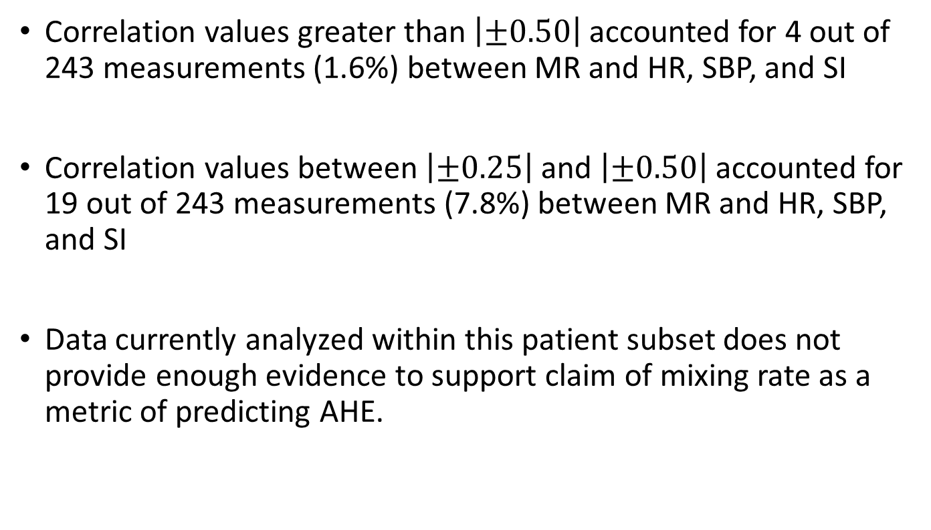
Conclusions
Correlation values greater than $\left|±0.50\right|$ accounted for 4 out of 243 measurements (1.6%) between MR and HR, SBP, and SI
Correlation values between $\left|±0.25\right|$ and $\left|±0.50\right|$ accounted for 19 out of 243 measurements (7.8%) between MR and HR, SBP, and SI
Data currently analyzed within this patient subset does not provide enough evidence to support claim of mixing rate as a metric of predicting AHE.

Slide 43
References
[1] M. Rady, E. Rivers, and R. Nowak, “Resuscitation of the critically ill in the ED: Responses of blood pressure, heart rate, shock index, central venous oxygen saturation, and lactate,” American Journal of Emergency Medicine, vol. 14, no. 2, pp. 218–225, Mar. 1996.
[2] D. S. Kauvar, R. Lefering, and C. E. Wade, “Impact of Hemorrhage on Trauma Outcome: An Overview of Epidemiology, Clinical Presentations, and Therapeutic Considerations,” The Journal of Trauma: Injury, Infection, and Critical Care, vol. 60, no. 6, pp. S3–S11, Jun. 2006.
[3] R. Nadler, V. A. Convertino, S. Gendler, G. Lending, A. M. Lipsky, S. Cardin, A. Lowenthal, and E. Glassberg, “The Value of Noninvasive Measurement of the Compensatory Reserve Index in Monitoring and Triage of Patients Experiencing Minimal Blood Loss,” Shock, vol. 42, no. 2, pp. 93–98, Mar. 2014.
[4] D. A. Levin, Y. Peres, E. L. Wilmer, J. Propp, and D. B. Wilson, Markov Chains and Mixing Times. Providence, RI: American Mathematical Society, 2017.
[5] M. Adibuzzaman, G. C. Kramer, L. Galeotti, S. J. Merrill, D. G. Strauss, and C. G. Scully, “The Mixing Rate of the Arterial Blood Pressure Waveform Markov Chain is Correlated with Shock Index During Hemorrhage in Anesthetized Swine,” 36th Annual International Conference of the IEEE Engineering in Medicine and Biology Society, pp. 3268–3271, Nov. 2014.
[6] S. J. Guastello, Nonlinear dynamical systems analysis for the behavioral sciences using real data. Boca Raton: CRC Press, 2011.
[5] M. Adibuzzaman, S. J. Merrill, and R. Povinelli, “A Systematic Approach for Algorithm Development for Identifying Changes in System Dynamics from Time Series ,” working paper.
[6] T. Berger, J. Green, T. Horeczko, Y. Hagar, N. Garg, A. Suarez, E. Panacek, and N. Shapiro, “Shock Index and Early Recognition of Sepsis in the Emergency Department: Pilot Study,” Western Journal of Emergency Medicine, vol. 14, no. 2, pp. 168–174, Jan. 2013.
[7] M. Adibuzzaman, K. Musselman, A. Johnson, P. Brown, Z. Pitluk, and A. Grama, “Closing the Data Loop: An Integrated Open Access Analysis Platform for the MIMIC Database,” 2016 Computing in Cardiology Conference (CinC), vol. 43, 2016.
[8] Goldberger AL, Amaral LAN, Glass L, Hausdorff JM, Ivanov PCh, Mark RG, Mietus JE, Moody GB, Peng C-K, Stanley HE. PhysioBank, PhysioToolkit, and PhysioNet: Components of a New Research Resource for Complex Physiologic Signals. Circulation 101(23):e215-e220; 2000 (June 13).

